Slide 1


AGILE Development
By: Parker McKay

Slide 2
AGILE Roles
Product Owner
Maximizes value of the product and work of the Development Team
Scrum Master
Provides guidance in AGILE principals
Servant Leader to the Product Owner
Facilitates Scrum events
Development Team
Consists of Developers and Testers
Self Organized

Slide 3
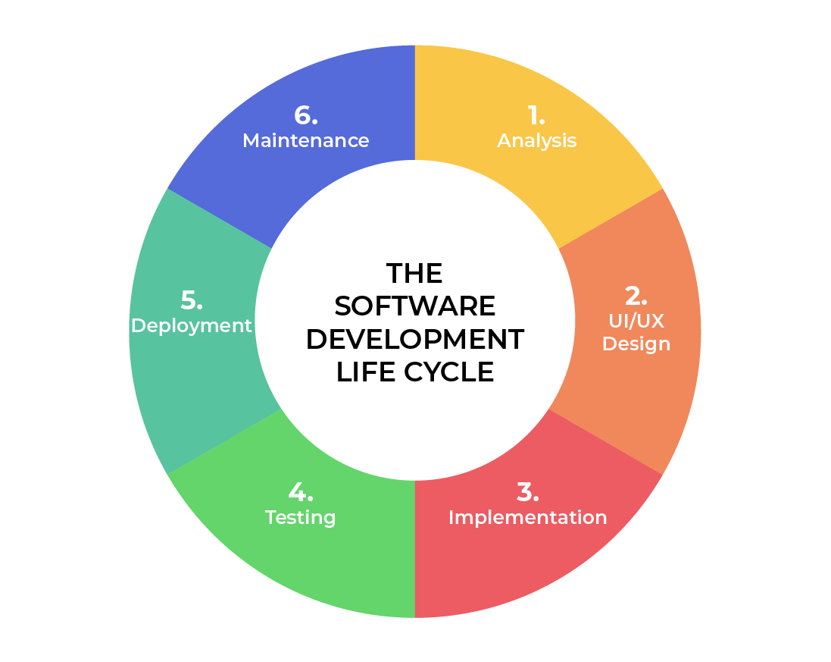
Software Development Lifecycle
Analysis
Collaborate with stakeholders
Refine Requirements
Design
Define detailed process for functionality
Define limitations, time frames, and budget
Implementation
Development begins
Functionality is broken up into smaller jobs
Testing
Occurs in conjunction with development
Process for identifying and mitigating defect and issues
Deployment
Testing complete and product is released to market
Maintenance
Product in production environment
Developers must be ready to implement new features and bug fixes as they appear

Slide 4
AGILE vs Waterfall
No need to define all requirements
Major requirements can be defined but functionality can evolve over time
No time to market constraint
All requirements must be defined
Contract Negotiation
Sequential/Linear stages
Best for simple, unchanging projects

Slide 5
References
Charles G. Cobb. (2015). The Project Manager’s Guide to Mastering Agile : Principles and Practices for an Adaptive Approach. Wiley.
Paredes, Rob. “Understanding Waterfall Methodology.” SafetyCulture, 6 June 2024, safetyculture.com/topics/waterfall-methodology/.

